Slide 1
Modeling Computation
Chapter 13
Copyright © McGraw-Hill Education. All rights reserved. No reproduction or distribution without the prior written consent of McGraw-Hill Education.

Slide 2
Chapter Summary
Languages and Grammars
Finite-State Machines with Output
Finite-State Machines with No Output
Language Recognition
Turing Machines

Slide 3
Languages and Grammars
Section 13.1

Slide 4
Section Summary
Phrase-Structure Grammars
Types of Phrase-Structure Grammars
Derivation Trees
Backus-Naur Form

Slide 5
Introduction
Syntax (form of a sentence) vs. semantics (meaning of a sentence)
The sentence the frog writes neatly is a valid sentence according to the rules of English grammar. That is, it is syntactically correct, even though it’s nonsensical (unless we are talking about a fantasy world).
The sequence of words swims quickly mathematics is not a valid sentence according to the rules of English grammar.

Slide 6
Grammars
The rules that specify the syntactically correct sentences of a natural language such as English are complex.
Instead of studying natural languages, we can define formal languages that have well-defined rules of syntax.
These rules of syntax are important both in linguistics (the study of natural languages) and in the study of programming languages.

Slide 7
An Example Grammar
a sentence is made up of a noun phrase followed by a verb phrase;
a noun phrase is made up of an article followed by an adjective followed by a noun, or
a noun phrase is made up of an article followed by a noun;
a verb phrase is made up of a verb followed by an adverb, or
a verb phrase is made up of a verb;
an article is a, or
an article is the;
an adjective is large, or
an adjective is hungry;
a noun is rabbit, or
a noun is mathematician;
a verb is eats, or
a verb is hops;
an adverb is quickly, or
an adverb is wildly.
We use these rules to form valid sentences by making a series of replacements until no more rules can be used.
An example sequence of replacements:
noun phrase verb phrase
article adjective noun verb phrase
article adjective noun verb adverb
the adjective noun verb adverb
the large noun verb adverb
the large rabbit verb adverb
the large rabbit hops adverb
the large rabbit hops quickly
Some additional valid sentences are:
a hungry mathematician eats wildly,
a large mathematician hops,
the rabbit eats quickly, etc.
But note that the following is not valid:
the quickly eats mathematician

Slide 8
Phrase-Structure Grammars
A vocabulary (or alphabet) V is a finite, nonempty set of elements called symbols.
A word (or sentence) over V is a string of finite length of elements of V.
The empty string or null string, denoted by λ, is the string containing no symbols.
The set of all words over V is denoted by V*. A language over V is a subset of V*.
The elements of V that can not be replaced by other symbols are called terminals, e.g., a, the, and rabbit in the example grammar.
Those that can be replaced by other symbols are called nonterminals, e.g., sentence, noun phrase, etc.
The rules that specify when we can replace a string V* with another string are called productions of the grammar. We denote by z₀ → z₁ the production that specifies that z₀ can be replaced by z₁ within a string.

Slide 9
Phrase-Structure Grammars (cont.)
A phrase-structure grammar G =(V, T, S, P) consists of a vocabulary V, a subset T of V consisting of terminal symbols, a start symbol S from V, and a finite set of productions P.
The set N = V −T is the set of nonterminal symbols.
Every production in P must contain at least one nonterminal on its left side.
Example (Grammar 1): Let G =(V, T, S, P), where V = {a, b, A, B, S}, T = {a,b}, S is the start symbol, and P = {S →Aba, A →BB, B →ab, AB →b}.

Slide 10
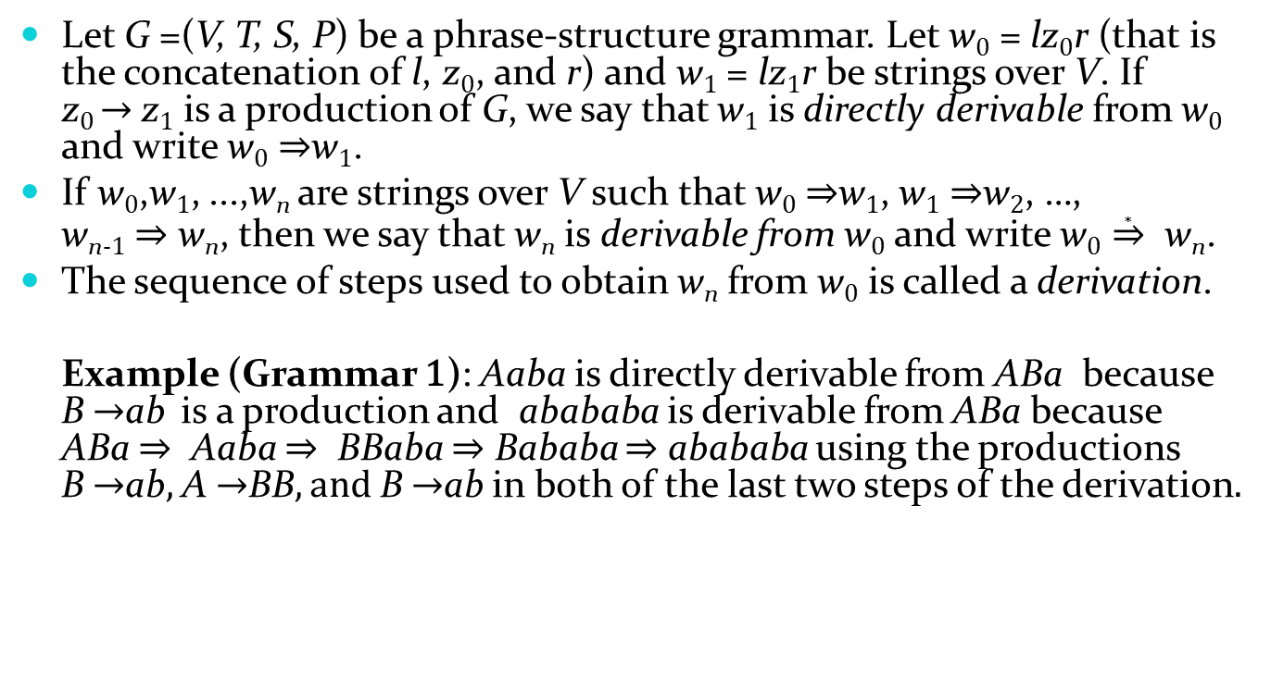
Derivations
Let G =(V, T, S, P) be a phrase-structure grammar. Let w₀ = lz₀r (that is the concatenation of l, z₀, and r) and w₁ = lz₁r be strings over V. If z₀ → z₁ is a production of G, we say that w₁ is directly derivable from w₀ and write w₀ ⇒w₁.
If w₀,w₁, ...,w_{n} are strings over V such that w₀ ⇒w₁, w₁ ⇒w₂, …, w_{n-1} ⇒ w_{n}, then we say that w_{n} is derivable from w₀ and write w₀ $\underset{⇒}{∗}$ w_{n}.
The sequence of steps used to obtain w_{n} from w₀ is called a derivation.
Example (Grammar 1): Aaba is directly derivable from ABa because B →ab is a production and abababa is derivable from ABa because ABa ⇒ Aaba ⇒ BBaba ⇒ Bababa ⇒ abababa using the productions B →ab, A →BB, and B →ab in both of the last two steps of the derivation.

Slide 11
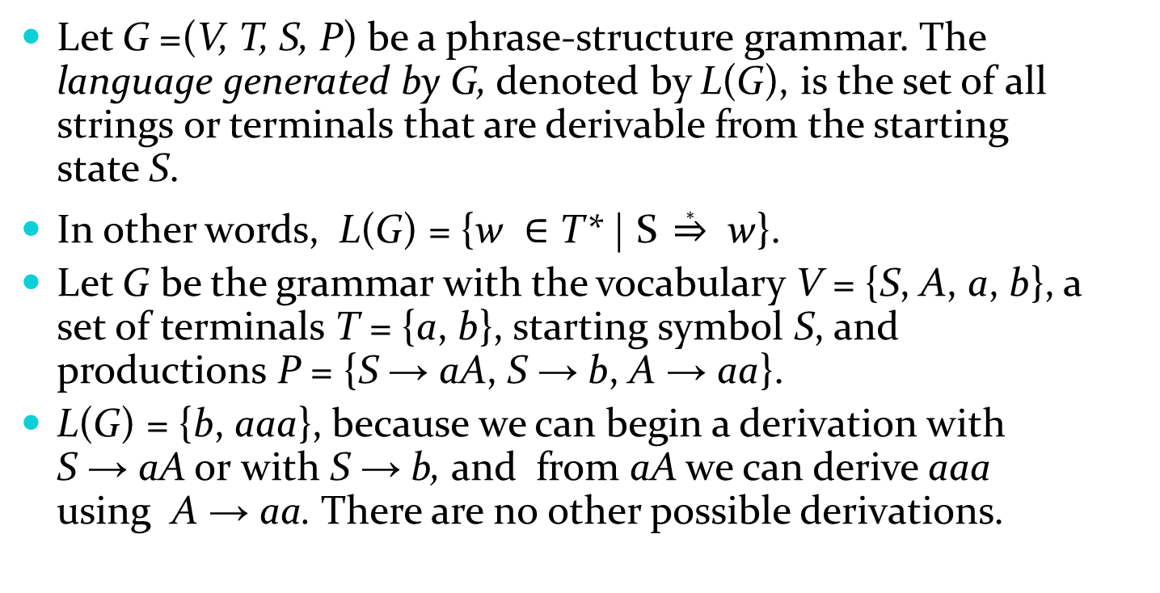
Language Generation
Let G =(V, T, S, P) be a phrase-structure grammar. The language generated by G, denoted by L(G), is the set of all strings or terminals that are derivable from the starting state S.
In other words, L(G) = {w ∈ T* | S $\underset{⇒}{∗}$ w}.
Let G be the grammar with the vocabulary V = {S, A, a, b}, a set of terminals T = {a, b}, starting symbol S, and productions P = {S → aA, S → b, A → aa}.
L(G) = {b, aaa}, because we can begin a derivation with S → aA or with S → b, and from aA we can derive aaa using A → aa. There are no other possible derivations.

Slide 12
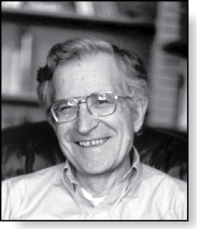
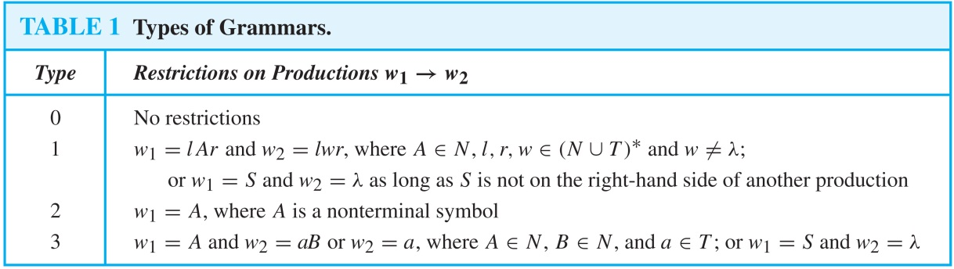
Types of Phrase Structure Grammars
Avram Noam Chomsky
(Born 1928)
Phrase-structure grammars are classified by the types of allowable productions.
Type 2 grammars are called context-free grammars. A language generated by a context-free grammar is called a context-free language.
Type 3 grammars are called context-sensitive grammars (or a regular grammar). A language generated by a context-sensitive grammar is called a context-sensitive language (or a regular language).

Slide 13
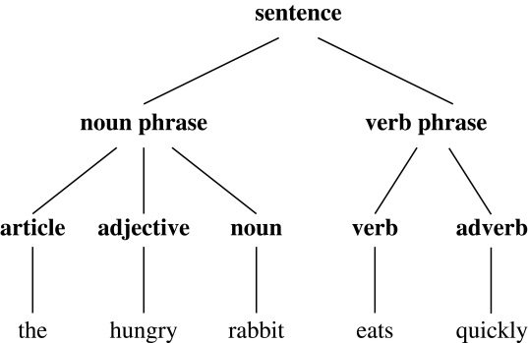
Derivation Trees
We can represent a derivation in the language generated by a context-free grammar by an ordered rooted tree, called a derivation, or parse tree.
The root of the tree represents the start symbol.
The internal vertices represent the nonterminal symbols that arise in the derivation.
The leaves represent the terminal symbols that arise.
If the production A →w, where w is a word, arises in the derivation, the vertex that represents A has as children vertices that represent each symbol in w, in order from left to right.
A derivation tree for the derivation of the hungry rabbit eats quickly, given the grammar described earlier.

Slide 14
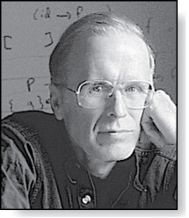
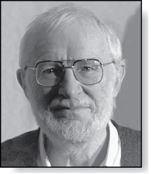
Backus-Naur Form
John Backus
(1924-2007)
Peter Naur
(Born 1928)
Backus-Naur form (BNF) is sometimes used to specify a type 2 grammar. It is often used to specify the syntactic rules of computer languages.
The productions of a type 2 grammar have a single nonterminal symbol on their left-hand side.
All the productions with the same nonterminal symbol on the left-hand side are combined into one statement using the symbol ::= instead of →. Additionally,, all nonterminal symbols are enclosed in brackets (〈〉), and the right-hand side of productions are spearated by bars.
For example, the productions A →Aa, A →a, and A →AB are written as 〈A〉 ::= 〈A〉a | a | 〈A〉 〈B〉.

Slide 15
BNF and ALGOL 60
In the programming language ALGOL 60 an identifier consists of a string of alphanumeric characters and must begin with a letter.
The BNF description of allowable identifiers is:
〈identifier〉 ::=〈letter〉 | 〈identifier〉〈letter〉 | 〈identifier〉〈digit〉
〈letter 〉 ::= a | b | ⋯ | y | z
〈digit〉 ::= 0 | 1 | ⋯ | 8 | 9
x99a is a valid identifier since the first rule can be used to replace 〈identifier〉 by 〈identifier〉〈letter〉 , the second rule to obtain 〈identifier〉 a, the first rule twice to obtain 〈identifier〉〈digit〉〈digit〉 a, the third rule twice to obtain 〈identifier〉99a, the first rule to obtain 〈letter〉99a, and finally the second rule to obtain x99a.

Slide 16
Finite-State Machines with Output
Section 13.2

Slide 17
Section Summary
Finite-State Machines (FSMs) with Outputs
Types of Finite-State Machines with Outputs (not currently included in overheads)

Slide 18
Introduction
Many kinds of machines, including computers, can be modeled using a structure called a finite-state machine (or finite automaton).
A finite-state machine consists of a finite set of states, a designated start state, an input alphabet, and a transition function that assigns a next state to every (state, input) pair
As we will see in Sections 13.2 − 13.4, some types of finite-state machines produce output, while for other types of finite-state machines that do not produce output some states are designated as accepting states.
Finite-state machines are used in many diverse applications, including spell-checking programs, grammar checking, indexing, searching large bodies of text, speech recognition, XML, HTML, and network protocols

Slide 19
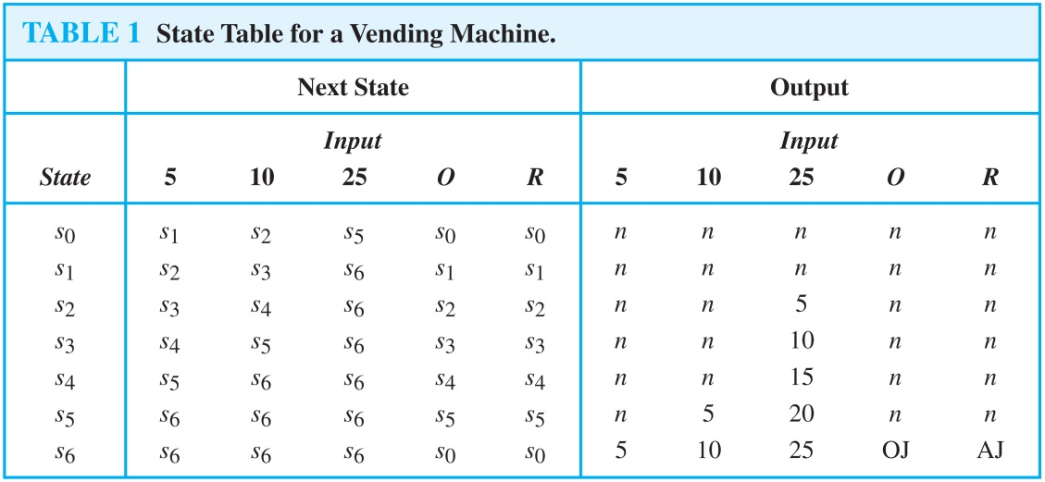
An Example of a Finite-State Machine with Output
A vending machine accepts nickels (5 cents) , dimes (10 cents) , and quarters (25 cents). When 30 cents or more has been deposited, the machine returns the amount over 30 cents. The customer can then press an orange button to receive a container of orange juice or a red button to receive a container of apple juice.
The machine can be in any of the states s_{i}, i = 0, …, 6, where s_{i} is the state where the machine has received 5i cents. The machine starts in state s₀, with 0 cents received. The possible inputs are 5 cents, 10 cents, 25 cents, the orange button (O), and the red button (R). The possible outputs are nothing (n), 5 cents, 15 cents, 20 cents, 25 cents, an orange juice, and an apple juice.

Slide 20
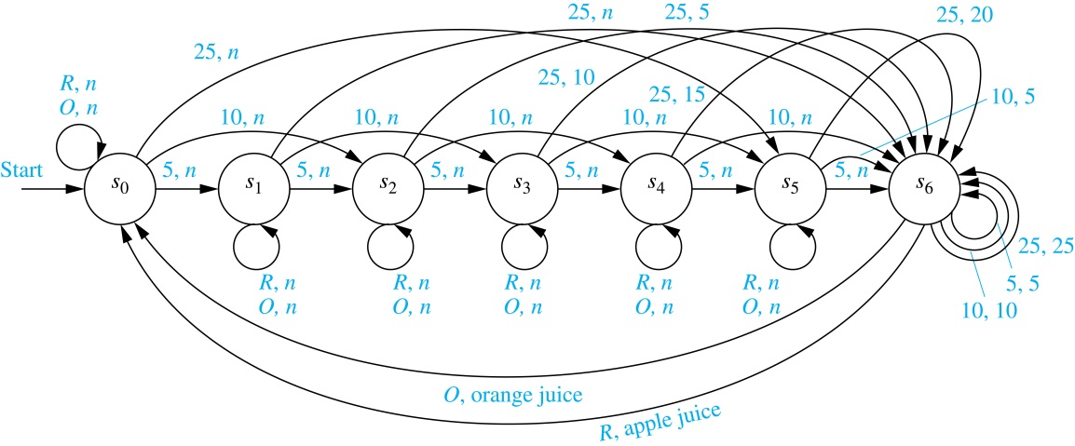
An Example (cont.)
We represent this vending machine using a directed graph with labeled edges, where each state is represented by a circle, edges represent transitions, and edges are labeled with the input and output for that transition.
We will trace the transitions and outputs of the vending machine when a student puts in a dime followed by a quarter, receives 5 cents back, and then pushes the orange button and receives an orange juice.
The machine starts in state s₀.
The first input is 10 cents, which changes the state to s₂ and gives no output.
After the second input of 25 cents, the state changes to s₆ and gives 5 cents as output.
The last input is the orange button, which changes the state back to s₀ and gives an orange juice as output.

Slide 21
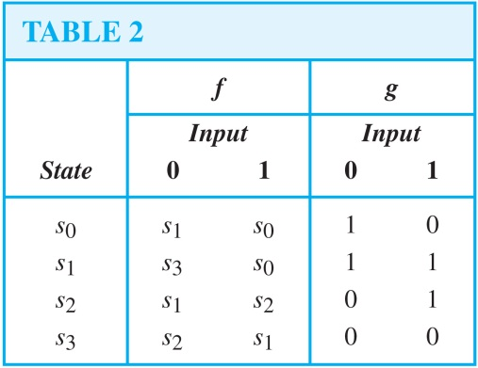
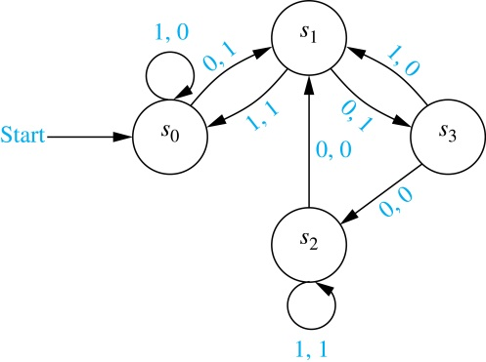
FSMs with Outputs
A finite-state machine M =(S, I, O, f, g, s₀) consists of a finite set S of states, a finite input alphabet I, a finite output alphabet O, a transition function f that assigns to each state and input pair a new state, an output function g that assigns to each state and input pair an output, and an initial state s₀ .
A state table is used to represent the values of the transition function f and the output function g for all (state, input).
Alternatively, a finite-state machine can be represented by a state diagram, which is a directed graph with labeled edges. Each state is represented by a circle, and arrows labeled with the input and output pair represent the transitions.
The state table and state diagram both represent the finite state machine with S = {s₀ ,s₁ ,s₂ ,s₃}, I = {0, 1}, and O = {0, 1}.

Slide 22
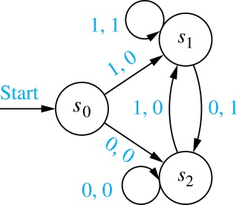
Unit-delay Machine
An important element in many electronic devices is a unit-delay machine, which produces as output the input string delayed by a specified amount of time, i.e., padded with an initial string of 0s.
How can a finite-state machine be constructed that delays an input string by one unit of time, that is, produces as output the bit string 0x₁x₂…x_{k-1} given the input bit string x₁x₂…x_{k-1}?
A delay machine can be constructed that has 0 or 1 as possible inputs. The machine has the start state s₀. The transition from s₀ produces an output of 0. The machine is in state s₁ if the previous input was a 1 and it produces 1 as output for its next transition, and in state s₂ if the previous input was 0 and it produces an output of 0 for its next transition.

Slide 23
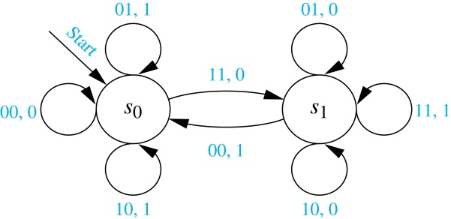
Addition Machine
We will construct a finite-state machine that adds two positive integers using their binary expansions.
Recall the conventional procedure to add (x_{n}…x₁x₀)₂ and (y_{n}…y₁y₀)₂ .
First, the bits x₀ and y₀ are added, producing a sum bit z₀ and a carry bit c₀. Next the bits x₁ and y₁ are added together with the carry bit c₀. This gives a sum bit z₁ and a carry bit c₁.
The procedure continues until the nth stage, where x_{n}, y_{n} and the previous carry c_{n-1} are added to produce the sum bit z_{n} and the carry bit c_{n}, which is equal to the sum bit z_{n+1}.
We can construct a finite state machine that uses just two states.
The start state s₀ is used to remember that the previous carry is 0.
The other state s₁ is used to remember that the previous carry is 1. (For simplicity, we assume that both x_{n} and y_{n} are 0.)
The inputs are pairs of bits. The transitions and the outputs are constructed from the sum of the two bits in the input and the carry represented by the state.
For example, when the machine is in state s₁ and receives 01 as input, the next state is s₁ and the output is 0, because the sum 0 + 1 + 1 =(10)₂.

Slide 24
Finite-State Machines with No Output
Section 13.3

Slide 25
Section Summary
Set of Strings
Finite-State Automata
Language Recognition by Finite-State Machines
Designing Finite-State Automata
Equivalent Finite-State Automata (not currently included in overheads)
Nondeterministic Finite-State Automata

Slide 26
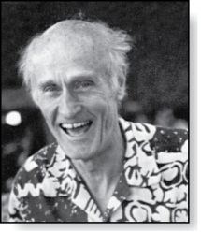
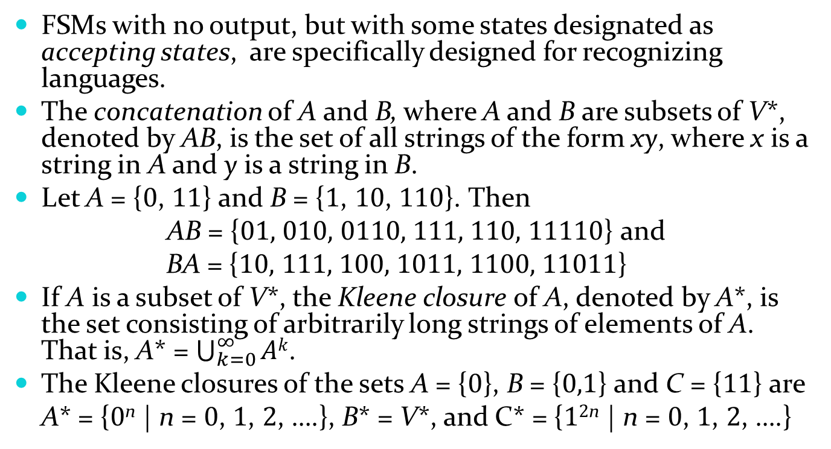
Set of Strings
Stephen Cole Kleene
(1909-1994)
FSMs with no output, but with some states designated as accepting states, are specifically designed for recognizing languages.
The concatenation of A and B, where A and B are subsets of V*, denoted by AB, is the set of all strings of the form xy, where x is a string in A and y is a string in B.
Let A = {0, 11} and B = {1, 10, 110}. Then
AB = {01, 010, 0110, 111, 110, 11110} and
BA = {10, 111, 100, 1011, 1100, 11011}
If A is a subset of V*, the Kleene closure of A, denoted by A*, is the set consisting of arbitrarily long strings of elements of A. That is, A* = $\bigcup_{k=0}^{∞}{Ak}$.
The Kleene closures of the sets A = {0}, B = {0,1} and C = {11} are
A* = {0^{n} | n = 0, 1, 2, ….}, B* = V*, and C* = {1^{2n} | n = 0, 1, 2, ….}

Slide 27
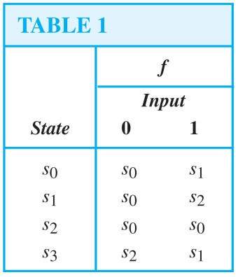
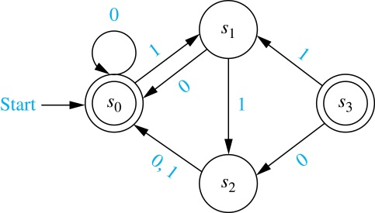
Finite-State Automata (FSA)
A finite-state automaton M = (S, I, f, s₀, F) consists of a finite set S of states, a finite input alphabet I, a transition function f that assigns a next state to every pair of state and input (so that f: S × I → S), an initial or start state s₀, and a subset F of S consisting of final (or accepting) states.
FSAs can be represented using either state tables or state diagrams, in which final states are indicated with a double circle.
The state diagram for the FSA M = (S, I, f, s₀, F), where S = {s₀, s₁, s₂,s₃}, I = {0, 1}, F = {s₀,s₃}, and the transition diagram is in Table 1, is shown here.

Slide 28
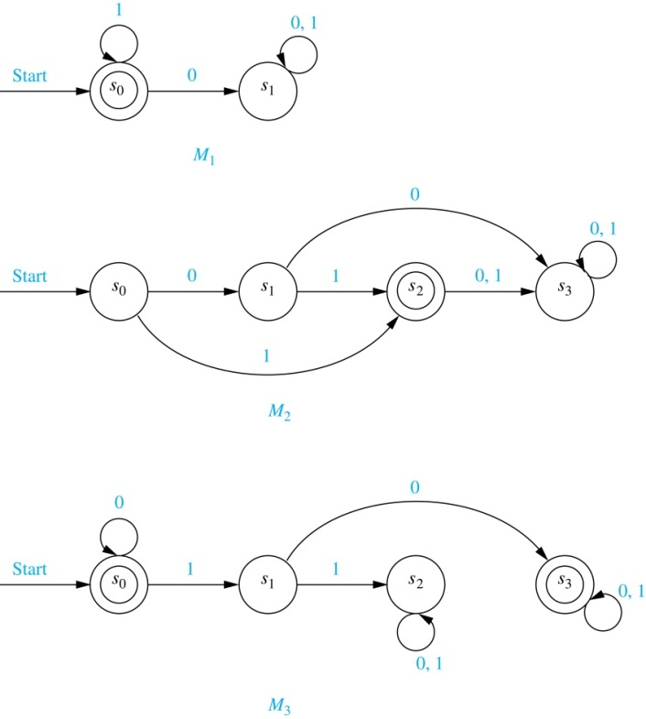
Language Recognition by FSAs
A string x is said to be recognized (or accepted) by the machine M = (S, I, f, s₀, F) if it takes the initial state s₀ to a final state, that is, f(s₀, x). The language recognized (or accepted) by M, denoted by L(M), is the set of all strings that are recognized by M. Two finite-state automata are called equivalent if they recognize the same language.
The only final state of M₁ is s₀. The strings that take s₀ to itself consist of zero or more consecutive 1s. Hence, L(M₁) = {1^{n} | n = 0, 1, 2, ….}.
The only final state of M₂ is s₂. The strings that take s₀ to s₂ are 1 and 01 . Hence , L(M₂) = {1, 01}.
The final state of M₃ are s₀ and s₃. The strings that take s₀ to itself are λ, 0, 00, 000,… . The strings that take s₀ to s₃ are a string of zero or more consecutive 0s, followed by 10, followed by any string. Hence, L(M₃) = {0^{n},0^{n}10x | n = 0, 1, 2, …., and x is any string}

Slide 29
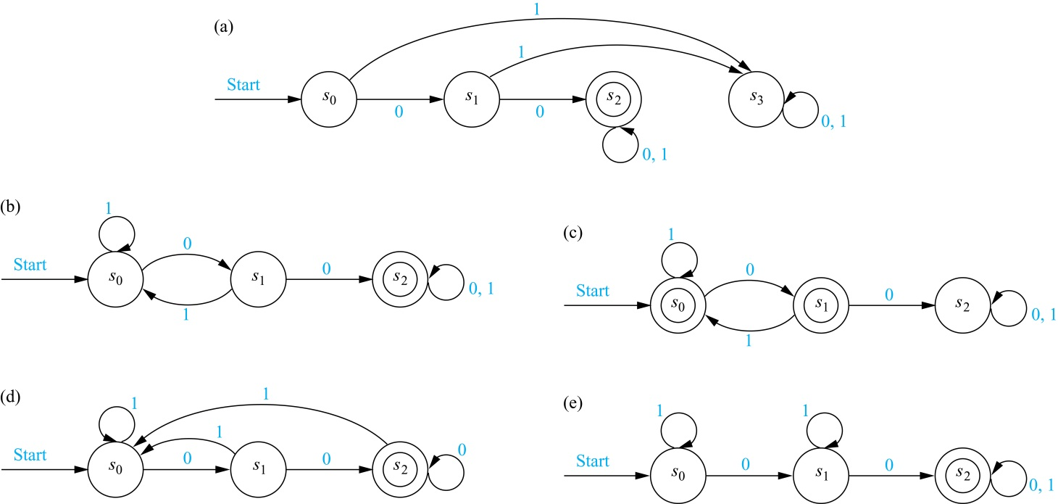
Language Recognition by FSAs (cont.)
Example: Construct a FSA that recognizes the set of bit strings that begin with two 0s.
Solution:
Besides the start state s₀, we include a nonfinal state s₁; we move to s₁ from s₀ if the first bit is a 0.
Next, we add a final state s₂, which we move to from s₁, if the second bit is a 0. We stay in this state no matter what the succeeding bits (if any) are.
We need a nonfinal state s₃, so that we can move to it from s₀ if the first bit is a 1 and from s₁ if the second bit is a 1.

Slide 30
Language Recognition by FSA (cont.)
Example: Construct a FSA that recognizes the set of bit strings that contain two consecutive 0s.
Solution:
Besides the start state s₀, we include a nonfinal state s₁, which tells us that the last input bit seen is a 0, but either the bit before was a 1, or this is the initial bit.
Next, we add a final state s₂, which we move to from s₁, if the next bit after a 0 is also 0. We stay in this state no matter what the succeeding bits (if any) are.
We return from s₀ or s₁ , if a 1 follows a 0 in the string, before we come to two consecutive 0s.

Slide 31
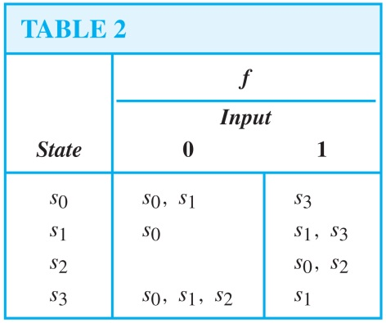
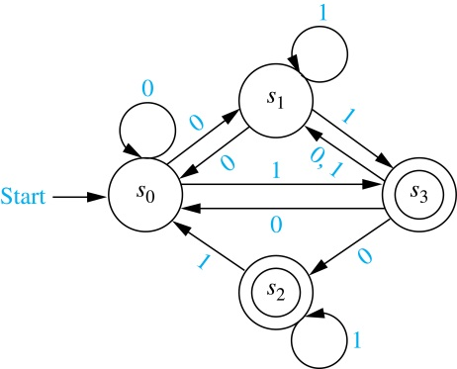
NDFSA
A nondeterministic finite-state automaton M = (S, I, f, s₀, F) consists of a finite set S of states, a finite input alphabet I, a transition function f that assigns a set of states to every pair of state and input (so that f: S × I → P(S)), an initial or start state s₀, and a subset F of S consisting of final (or accepting) states.
We can represent a nondeterministic finite-state automaton using a state table where we give a list of possible next states for each pair of a state and an input value.
We construct a state diagram for a nondeterministic automaton by including an edge from each state to all possible next states, labeling edges with the input or inputs that lead to this transition.
We use the abbreviation NDFSA for a nondeterministic finite-state automaton and DFSA for a deterministic finite-state automata when we needed to distinguish between NDFSA and DFSA.
Example: Find the state diagram for the NDFSA with the state table shown in Table 2. The final states are s₂ and s₃.
Solution:

Slide 32
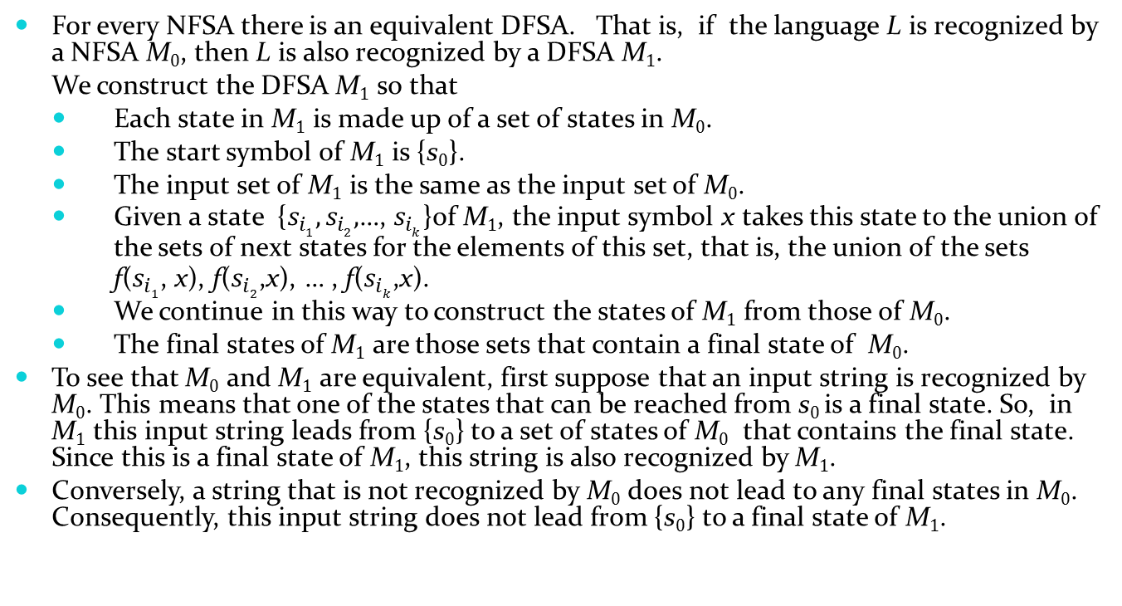
Finding a DFSA Equivalent to a NFSA
For every NFSA there is an equivalent DFSA. That is, if the language L is recognized by a NFSA M₀, then L is also recognized by a DFSA M₁.
We construct the DFSA M₁ so that
Each state in M₁ is made up of a set of states in M₀.
The start symbol of M₁ is {s₀}.
The input set of M₁ is the same as the input set of M₀.
Given a state {$s_{i1},s_{i2},$…, $s_{ik}$}of M₁, the input symbol x takes this state to the union of
the sets of next states for the elements of this set, that is, the union of the sets
f($s_{i1}$, x), f($s_{i2}$,x), … , f($s_{ik}$,x).
We continue in this way to construct the states of M₁ from those of M₀.
The final states of M₁ are those sets that contain a final state of M₀.
To see that M₀ and M₁ are equivalent, first suppose that an input string is recognized by M₀. This means that one of the states that can be reached from s₀ is a final state. So, in M₁ this input string leads from {s₀} to a set of states of M₀ that contains the final state. Since this is a final state of M₁, this string is also recognized by M₁.
Conversely, a string that is not recognized by M₀ does not lead to any final states in M₀. Consequently, this input string does not lead from {s₀} to a final state of M₁.

Slide 33
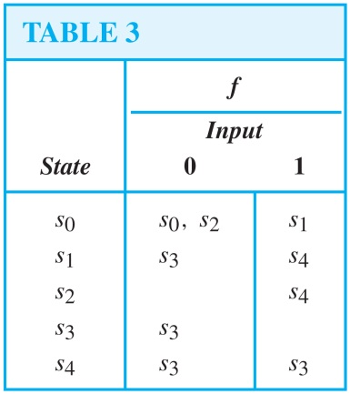
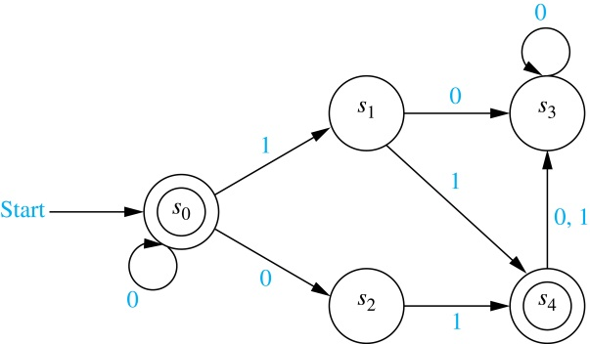
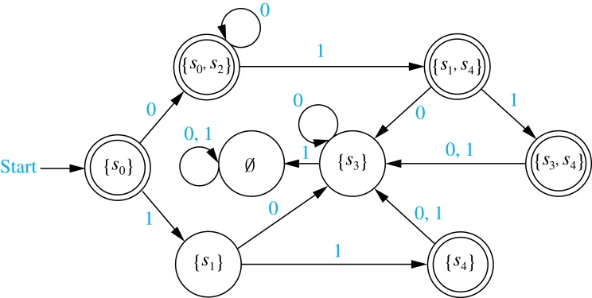
Finding an Equivalent DFSA (cont.)
Example: Find a DFSA that recognizes the same language as the NFSA:
Solution: Following the steps of the procedure described on the previous slide, we obtain the DFSA shown here.

Slide 34
Language Recognition
Section 13.4

Slide 35
Section Summary
Regular Expressions
Kleene’s Theorem
Regular Sets and Regular Grammars
More Powerful Types of Machines

Slide 36
Regular Expressions
The regular expressions over a set I are defined recursively by:
Each regular expression represents a set specified by these rules:
Sets represented by regular expressions are called regular sets.
the symbol ∅ is a regular expression;
the symbol λ is a regular expression;
the symbol x is a regular expression whenever x ∈ I;
the symbols (AB), (A ∪ B), and A* are regular expressions
whenever A and B are regular expressions.
∅ represents the empty set, that is, the set with no strings;
λ represents the set {λ}, which is the set containing the empty string;
x represents the set {x} containing the string with one symbol x;
(AB) represents the concatenation of the sets represented by A and by B;
(A ∪ B) represents the union of the sets represented by A and by B;
A* represents the Kleene closure of the set represented by A.

Slide 37
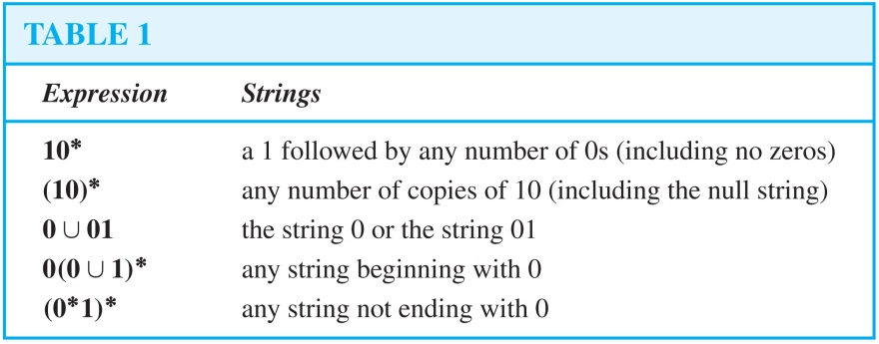
Regular Expressions (cont.)
Example: What are the strings in the regular sets specified by the regular expressions 10*, (10)*, 0 ∪ 01, 0(0 ∪ 1)*, and (0*1)*?
Solution:

Slide 38
Finite-State Automata, Regular Sets, and Regular Grammars
In 1956 Kleene established the connection between regular sets and sets recognized by a FSA.
He showed that a set is regular if and only if it is recognized by a FSA. This result is known as Kleene's theorem.
See the text for the lengthy proof of this theorem.
There is a close connection between regular grammars and regular sets.
Specifically, a set is generated by a regular grammar if and only if it is a regular set.
See the text for a proof.
We will give an example of a set that is not regular later in this section by finding a set that is not recognized by an FSA.

Slide 39
A Set Not Recognized by a FSA
The set {0^{n}1^{n} | n = 0, 1, 2, …} of all strings consisting of a block of 0s followed by a block of an equal number of 1s is not regular.
To show that this set is not regular, suppose that this set was regular. Then there would be a NDFSA M = (S, I, f, s₀, F) recognizing it.
Let N be the number of states in this machine, i.e., N = |S|.
M must recognize 0^{N}1^{N} since it is made up of a block of 0s followed by a block of an equal number of 1s.
Let s₀, s₁, s₂,…,s_{2N} be the sequence of states obtained starting at s₀ and using the symbols of 0^{N}1^{N} as input. So, s₁ =f(s₀ ,0), s₂ =f(s₁ ,0), …, s_{N} =f(s_{N-1} ,0), s_{N+1} =f(s_{N} ,1), …,s_{2N} = f(s_{2N-1} ,1), and s_{2N} is a final state.
Because there are only N states, by the pigeonhole principle at least two of the first N + 1 states s₀, s₂,…,s_{N} must be the same.
Suppose that s_{i} and s_{j} are identical states with 0 ≤ i < j ≤ N. This means that f(s_{i} ,0^{t})= s_{j}, where t = j − i. Hence, there is a loop leading from s_{i} back to itself, using 0 a total of t times.
continued

Slide 40
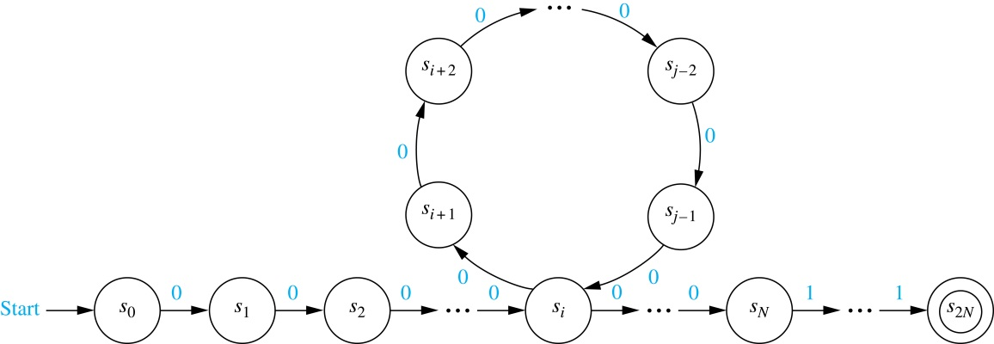
A Set Not Recognized by a FSA (cont.)
Now consider the input string 0^{N}0^{t}1^{N} = 0^{N+t}1^{N} . The string is not of the correct form and so, it is not recognized by M.
Consequently, f(s₀ ,0^{N+t}1^{N}) can not be a final state.
However, when we use the string 0^{N+t}1^{N} as input, we end up in the same state as before, namely, s_{2N}. The reason is that we go through the loop one more time.
This contradiction shows that {0^{n}1^{n} | n = 0, 1, 2, …} is not regular.

Slide 41
More Powerful Types of Machines
The main limitation of finite-state automata is their finite amount of memory. This has led to the development of more powerful types of machines.
Pushdown Automaton (PDA): includes a stack, which provides unlimited memory. We can use a PDA to recognize {0^{n}1^{n} | n = 0, 1, 2, …}, but no PDA recognizes the set {0^{n}1^{n}2^{n} | n = 0, 1, 2, …}.
Linear Bounded Automaton (LBA): More powerful than pushdown automata. We can use a LBA to recognize {0^{n}1^{n}2^{n} | n = 0, 1, 2, …}, but there are languages generated by phrase-structure grammars that cannot be recognized by a LBA.
Turing Machine (TM): Yet more powerful machines (to be studied in the next section) which can recognize all languages generated by phrase-structure grammars.

Slide 42
Turing Machines
Section 13.5

Slide 43
Section Summary
Definition of Turing Machines
Using Turing Machines to Recognize Sets
Computing Functions with Turing Machines
Different Types of Turing Machines (not currently included in overheads)
The Church-Turing Thesis
Computational Complexity, Computability, and Decidability

Slide 44
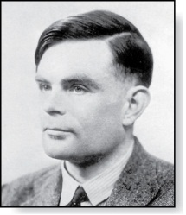
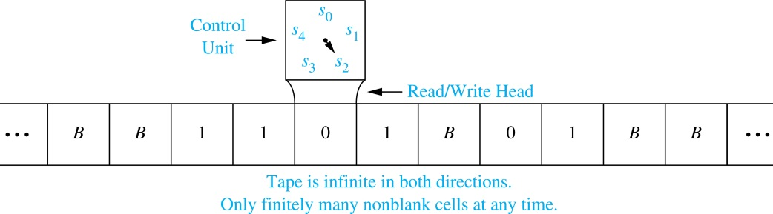
Introduction
Alan Mathison Turing
(1912-1954)
Informally, a Turing machine consists of a control unit, which at any step is in one of finitely many different states, together with a tape, infinite in both directions, which is divided into cells.
Turing machines have read and write capabilities on the tape as the control unit moves back and forth along this tape, changing states depending on the tape symbol read.
Turing machines are more powerful than finite-state machines because they include additional memory capability.
Turing machines are the most general models of computation; essentially they can do whatever a computer can do.

Slide 45
Definition of Turing Machines (TM)
A Turing machine T = (S, I, f, s₀) consists of
a finite set S of states,
an alphabet I containing the blank symbol B,
a partial function f from S × I to S × I ×{R,L}, and
a starting state s₀.
For some (state, symbol) pairs the partial function f may be undefined, but for a pair for which it is defined, there is a unique (state, symbol, direction) triple associated to this pair.
The five-tuples corresponding to the partial function in the definition of a TM are called the transition rules of the machine.
At each step, the control unit reads the current tape symbol x. If the control unit is in state s and if the partial function f is defined for the pair (s, x) with f(s, x) = (s′, x′, d), the control unit:
enters the state s′,
writes the symbol x′ in the current cell, erasing x, and
moves right one cell if d = R or moves left one cell if d = L.
This step is written as the five-tuple (s, x, s′, x′, d). Turing machines are defined by specifying a set of such five-tuples. If the partial function f is undefined for the pair (s, x) then T will halt.
At the beginning of its operation a TM is assumed to be in the initial state s₀ and to be positioned over the leftmost nonblank symbol on the tape. This is the initial position of the machine.

Slide 46
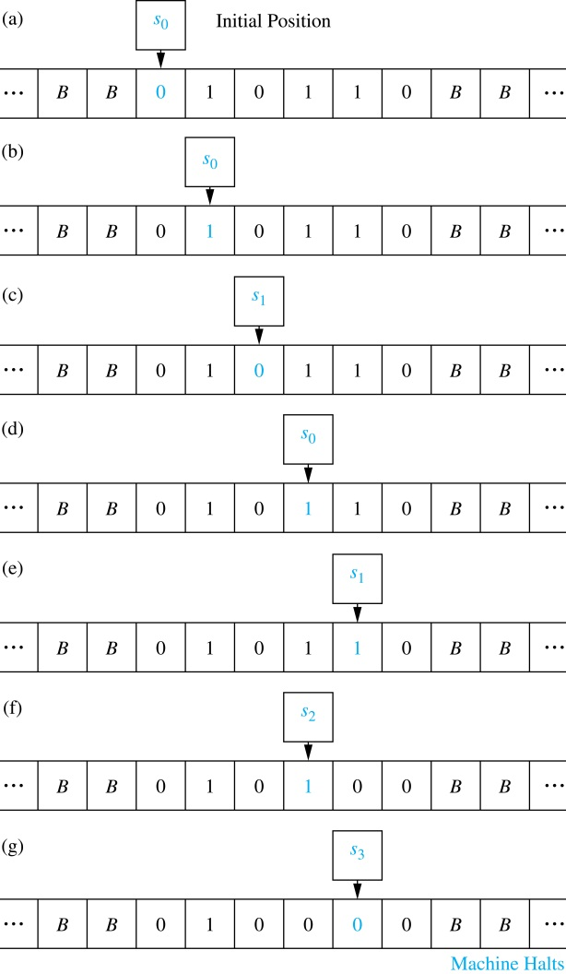
A TM in Operation
Example: What is the final tape when the TM T defined by the seven five-tuples (s₀, 0, s₀, 0, R), (s₀, 1, s₁, 1, R), (s₀, B, s₃, B, R), (s₁, 0, s₀, 0, R), (s₁, 1, s₂, 0, L), (s₁, B, s₃, B, R), and (s₂, 1, s₃, 0, R) is run on the tape shown here in (a)?
Solution: The transitions of this TM are shown to the right. The final tape is shown in (g).

Slide 47
Using TM to Recognize Sets
Let V be a subset of an alphabet I. A TM T = (S, I, f, s₀) recognizes a string x in V* if and only if T, starting in the initial position when x is written on the tape, halts in a final state.
T is said to recognize a subset A of V* if x is recognized by T if and only if x belongs to A.
Note that to recognize a subset A of V* we can use symbols not in V. This means that the input alphabet I may include symbols not in V. We will see that these extra symbols are used as markers.
A TM operating on a tape containing the symbols of a string x in consecutive cells, does not recognize x if it does not halt or halts in a state that is not final.

Slide 48
Using TMs to Recognize Sets (cont.)
In Section 13.4 we showed that there is no DFA that recognizes the set the set {0^{n}1^{n} | n ≥ 1}. We will now construct a TM that recongizes this set.
We use an auxiliary tape symbol M as a marker, and specify that V = {0, 1} and I = {0, 1, M}.
Our TM has one final state, s₆ . The TM successively replaces a 0 at the leftmost position of the string with an M and a 1 at the rightmost position of the string with an M, sweeping back and forth, terminating in a final state if and only if the string consists of a block of 0s followed by a block of the same number of 1s.
The five-tuples are (s₀, 0, s₁, M, R), (s₁, 0, s₁, 0, R), (s₁, 1, s₁, 1, R), (s₁, M, s₂, M, L), (s₁, B, s₂, B, L), (s₂, 1, s₃, M, L), (s₃, 1, s₃, 1, L), (s₃, 0, s₄, 0, L), (s₃, M, s₅, M, R), (s₄, 0, s₄, 0, L), (s₄, M, s₀, M, R), and (s₅, M, s₆, M, R).
For example, the string 000111 would successively become M00111, M0011M, MM011M, MM01MM, MMM1MM, MMMMMM as the machine operates until it halts.

Slide 49
Computing Functions with TMs
A Turing machine can be used to compute the values of a partial function.
Suppose that the TM T, when given the string x as input, halts with the string y on its tape. We can then define T(x) = y.
To consider a TM as a computer of functions from the set of k-tuples of nonnegative integers to the set of nonnegative integers, we use the unary representation of integers.
A nonnegative integer n is represented by a string of n + 1 1s. So, 0 is represented by 1, 5 by 111111, etc.
To represent an input that is a k-tuple of integers, we represent each integer in the k-tuple separately and separate these representations using asterisks. For example, (2,0,1,3) is represented by 111*1*11*1111.
Constructing a Turing machine that computes a particular function can be extremely complicated. Fortunately, the ability of Turing machines to compute functions is of theoretical, rather than practical, interest.

Slide 50
Computing Functions with TMs (cont.)
To construct a TM T that computes the function f(n₁,n₂) = n₁ + n₂, we first represent the pair (n₁,n₂) by a string of n₁ + 1 1s followed by an asterisk, followed by n₂ + 1 1s.
The machine starts at the leftmost 1 of the input string, and proceeds to erase this 1.
If the next character is an asterisk, n₁ = 0. In this case, it replaces the asterisk with a blank and halts.
Otherwise, it erases the next 1, and then passes over the remaining 1s, until it comes to the asterisk.
The asterisk is then replaced by a 1.
The five-tuples defining this Turing machine are: (s₀, 1, s₁, B, R), (s₁, ∗, s₃, B, R), (s₁, 1, s₂, B, R), (s₂, 1, s₂, 1, R), (s₂, ∗, s₃, 1, R).

Slide 51
The Church-Turing Thesis
The Church-Turing Thesis says that given any problem that can be solved with an effective algorithm, there is a TM that can solve this problem.
It is called a thesis rather than a theorem because the concept of solvability by an effective algorithm is informal and imprecise, as opposed to the concept of solvability by a TM, which is formal and precise.

Slide 52
Decidability and Complexity
A decision problem asks whether statements from a particular class of statements are true. Decision problems are also known as yes-or-no problems.
Consider the question for a particular integer n, “Is n prime?” The answer is "yes" or "no.“
The halting problem is the decision problem that asks whether a Turing machine T eventually halts when given an input string x.
When there is an effective algorithm that decides whether instances of a decision problem are true, we say that this problem is solvable or decidable.
In Section 3.5, an algorithm was given for determining whether a positive integer n is prime by checking whether it is divisible by primes not exceeding its square root.
However, if no effective algorithm exists for solving a problem, then we say the problem is unsolvable or undecidable.
The halting problem is an unsolvable decision problem (proved in Section 3.1). That is, no TM exists that, when given an encoding of a TM T and its input string x as input, can determine whether T eventually halts when started with x written on its tape.
A function that can be computed by a TM is called computable and a function that cannot be computed by a TM is called uncomputable.
The busy beaver function, which when given a positive integer n gives the maximum number of 1s that a TM with n states and alphabet {1,B} may print on an initially blank tape is uncomputable (see Exercise 35 in Section 13.5).

Slide 53
The Classes P and NP
In a nondeterministic Turing machine (NDTM), the restriction that no two transition rules begin with the same pair (s, x) is eliminated.
Hence, there may be more than one transition rule beginning with each (state, tape symbol) pair, so that there may be a choice as to which rule to use at each step.
A NDTM T recognizes a string x if and only if there exists some sequence of transitions of T that ends in a final state when the machine starts in the initial position with x written on the tape.

Slide 54
The Classes P and NP (cont.)
A decision problem is in P, the class of polynomial-time problems, if it can be solved by a deterministic Turing machine in polynomial time in terms of the size of its input.
That is, a decision problem is in P if there is a deterministic Turing machine T that solves the decision problem and a polynomial p(n) such that for all integers n, T halts in a final state after no more than p(n) transitions whenever the input to T is a string of length n.
A decision problem is in NP, the class of nondeterministic polynomial-time problems, if it can be solved by a nondeterministic Turing machine in polynomial time in terms of the size of its input.
That is, a decision problem is in NP if there is a nondeterministic Turing machine T that solves the problem and a polynomial p(n) such that for all integers n, T halts for every choice of transitions after no more than p(n) transitions whenever the input to T is a string of length n.
Problems in P are called tractable, whereas problems not in P are called intractable.

Slide 55
The Classes P and NP (cont.)
For a problem to be in NP, it is necessary only that there be a NDTM that when given a true statement from the set of statements addressed by the problem, can verify its truth in polynomial time by making the correct guess at each step.
The problem of determining whether a given graph has a Hamilton circuit is an NP problem, because a NDTM can easily verify that a simple circuit in a graph passes through each vertex exactly once.
It can do this by making a series of correct guesses corresponding to successively adding edges to form the circuit.

Slide 56
Wrapping Everything up with a Millenium Problem
Because every DTM can also be a considered to be a NDTM, where each (state, tape symbol) pair occurs in exactly one transition rule, P ⊆ NP.
The most famous open question in theoretical CS, and one of the millennium problems with a $1,000,000 prize, is whether every problem in NP is also in P, that is, whether P = NP.
There is an important class of problems, known as NP-complete problems, where a problem is in this class if it is the class NP and if this problem was also in the class P, then every problem in NP must also be in P.
That is, a problem is NP-complete if the existence of a polynomial-time algorithm for solving it implies the existence of a polynomial-time algorithm for every problem in NP.
We have studied several problems that can be shown to be NP-complete in this text, including determining whether a simple graph has a Hamilton circuit and determining whether a proposition in n variables is a tautology.
This concludes our introduction to discrete mathematics, but it should come as no surprise that there is a lot more to learn!

